Slide 1
Welcome

Slide 2

Grocery Delivery Shop
Presented By:
Vrushali Kadam (Batch-6522)
Center:Thane
Guided By:
Chittaranjan Ghos
Technical Trainer
EduBridge
(School of coding)

Slide 3
INTRODUCITON
Online Grocery Shop is a form of ecommerce that allows consumers to directly buy fresh food staffs or produce from a seller over the internet. An online grocery shop evokes the physical analogy of buying produce like it is done in a local market. The largest online retailing corporations are e-Bay and Amazon.com, both of which are based in the US. These giant online shops have with time been able to add to their sales the ability to sell fresh food and other home products through the internet.

Slide 4
Software Requirements:
Front end: HTML , CSS , Javascript
Back end: Java, MySQL
Operating System: Windows 10

Slide 5
Modules:
Shopping Management:
Customer Management:
Manage Transactions:
Seller Management:

Slide 6
Data Dictionary

Slide 7
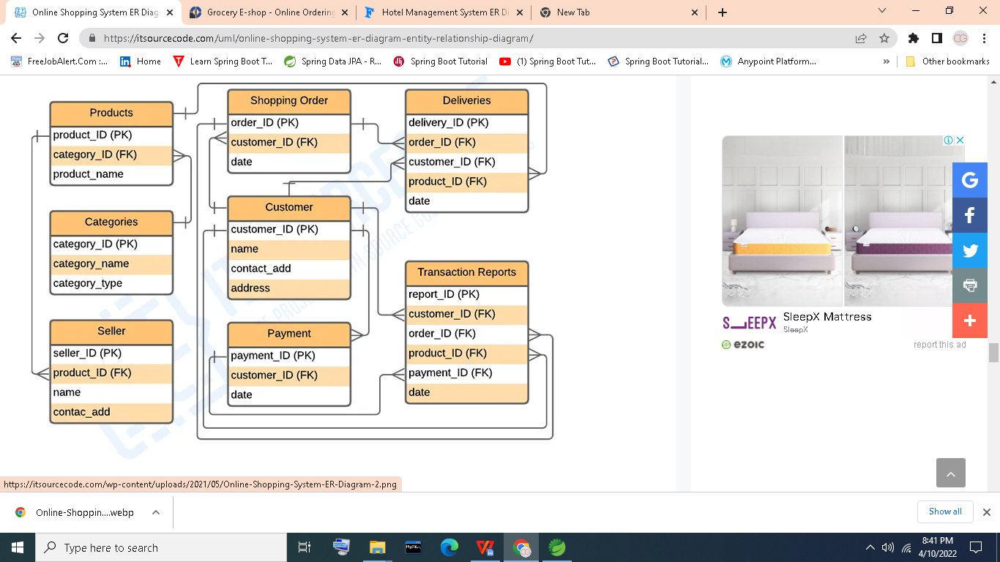

Slide 8
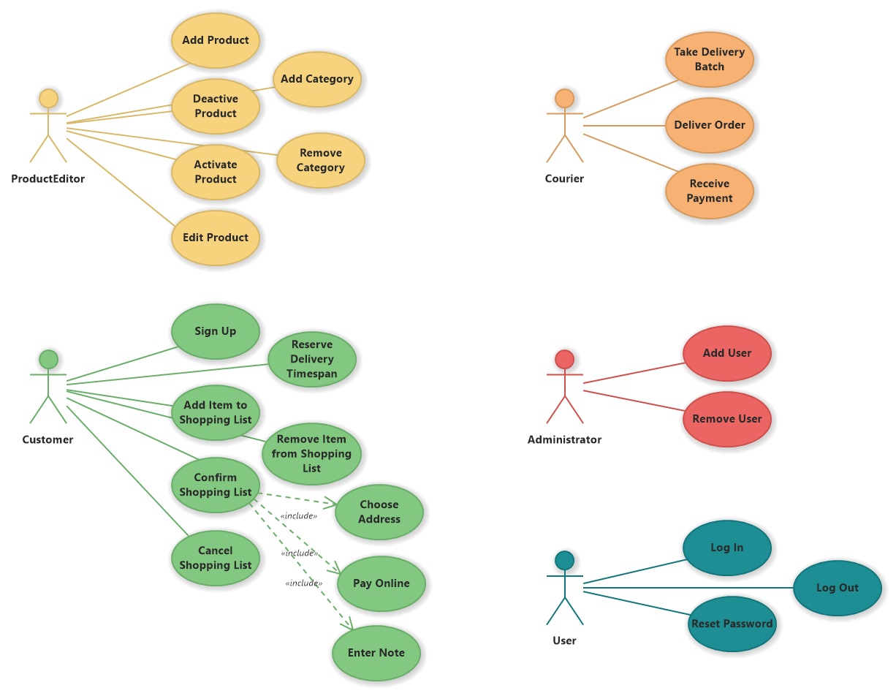

Slide 9
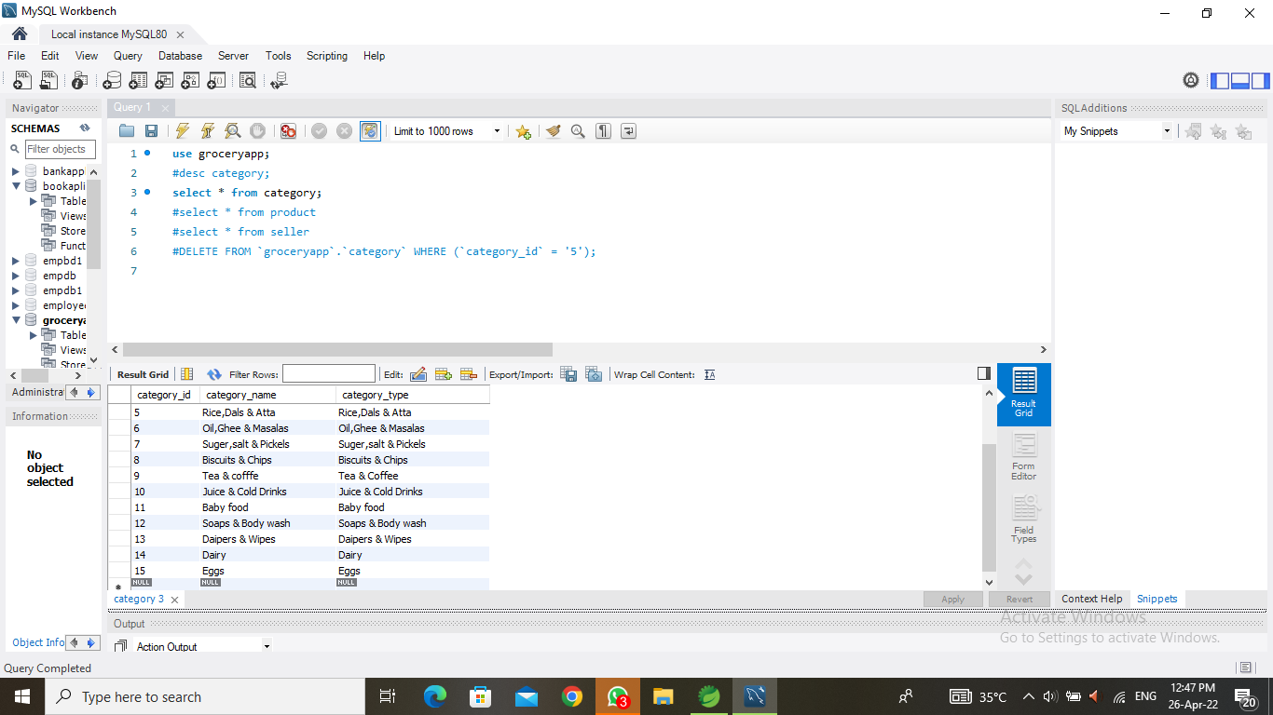

Slide 10
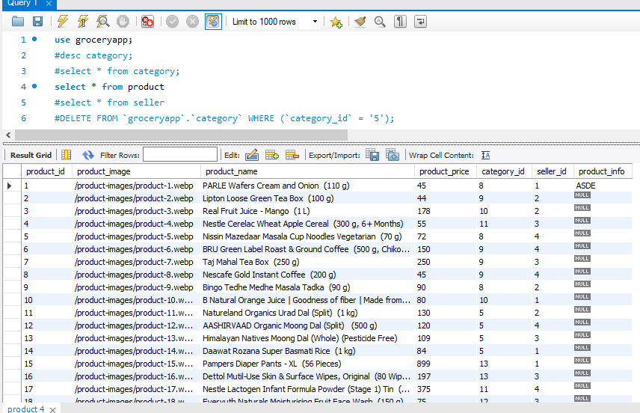

Slide 11
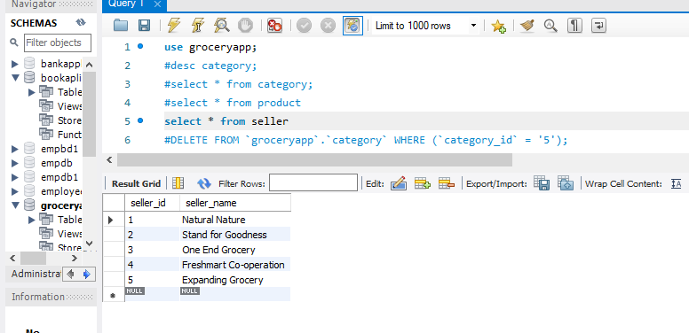

Slide 12
Output Section

Slide 13
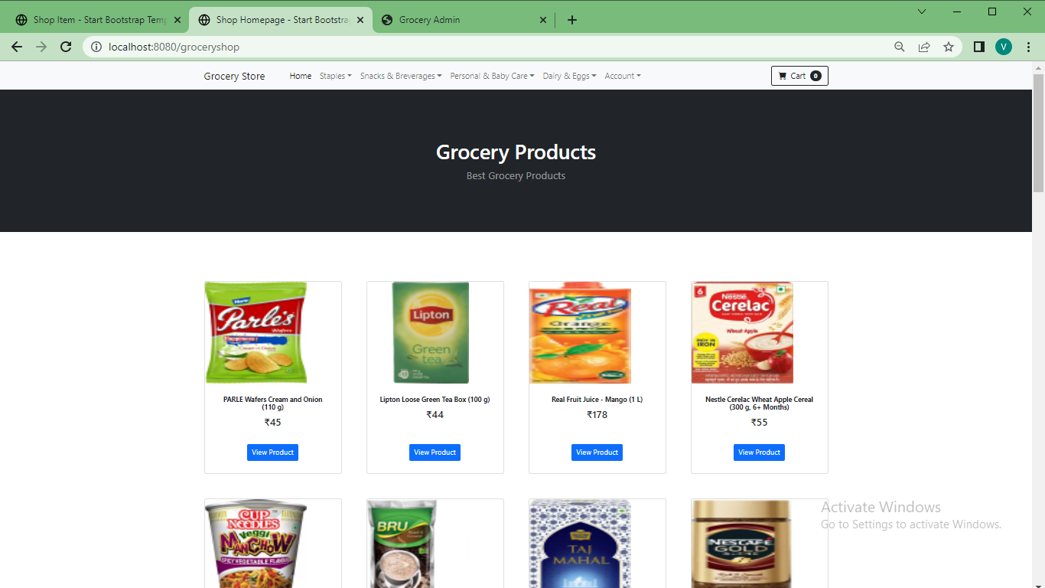

Slide 14
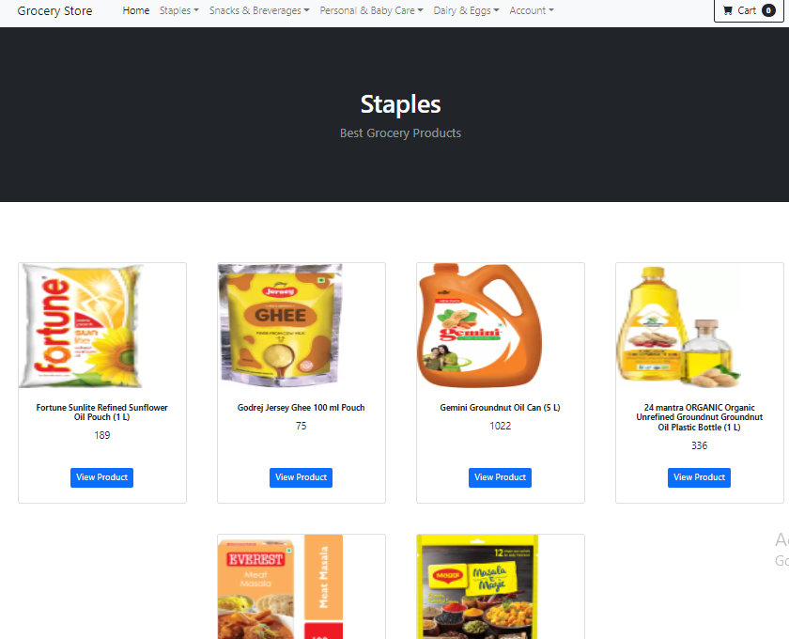

Slide 15
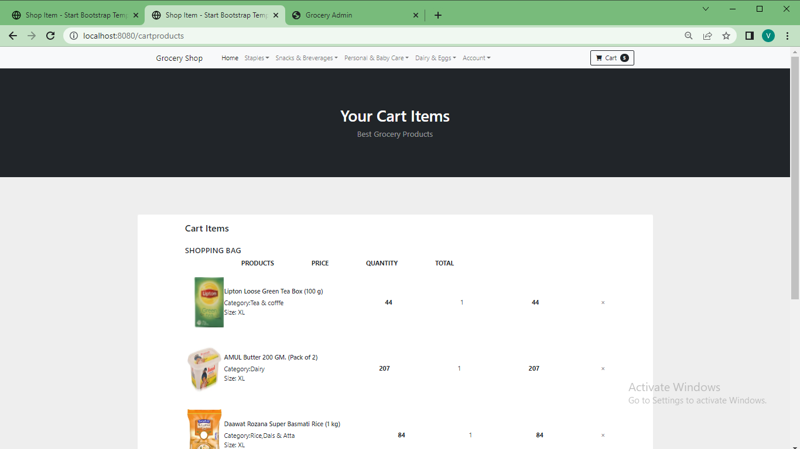

Slide 16
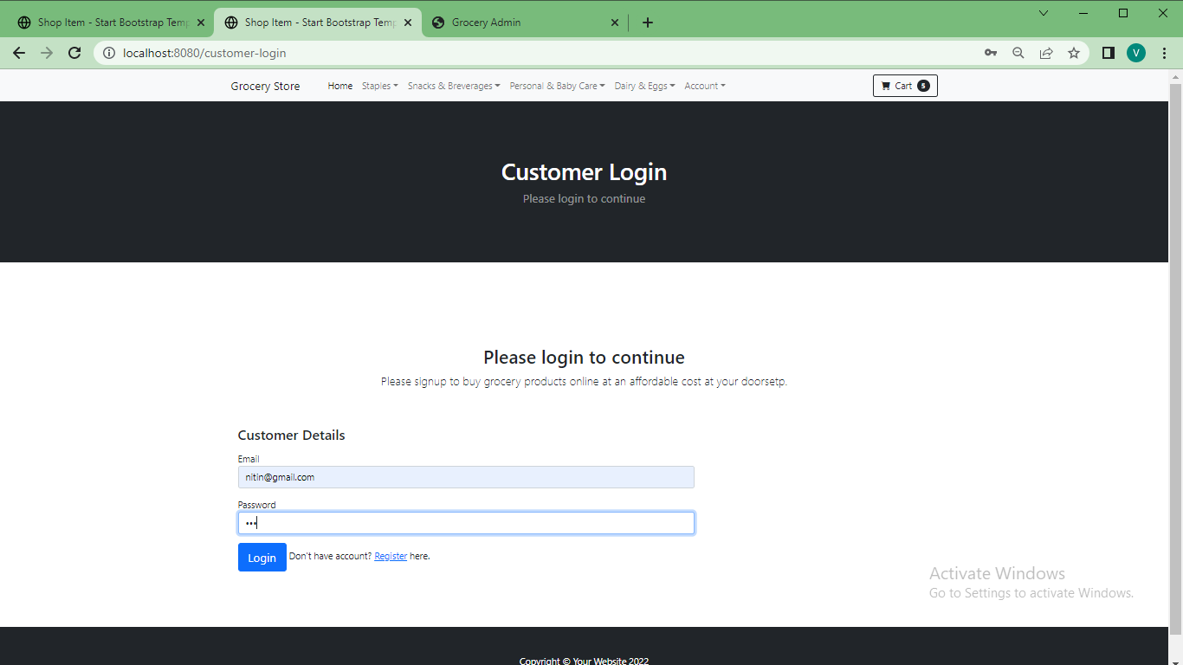

Slide 17
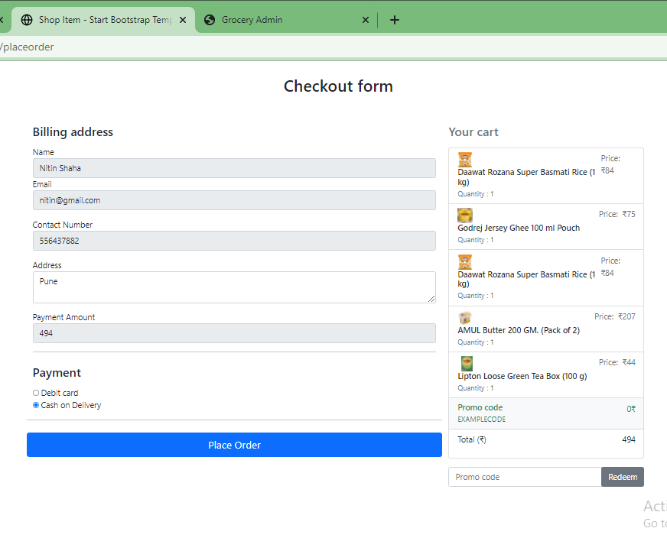

Slide 18
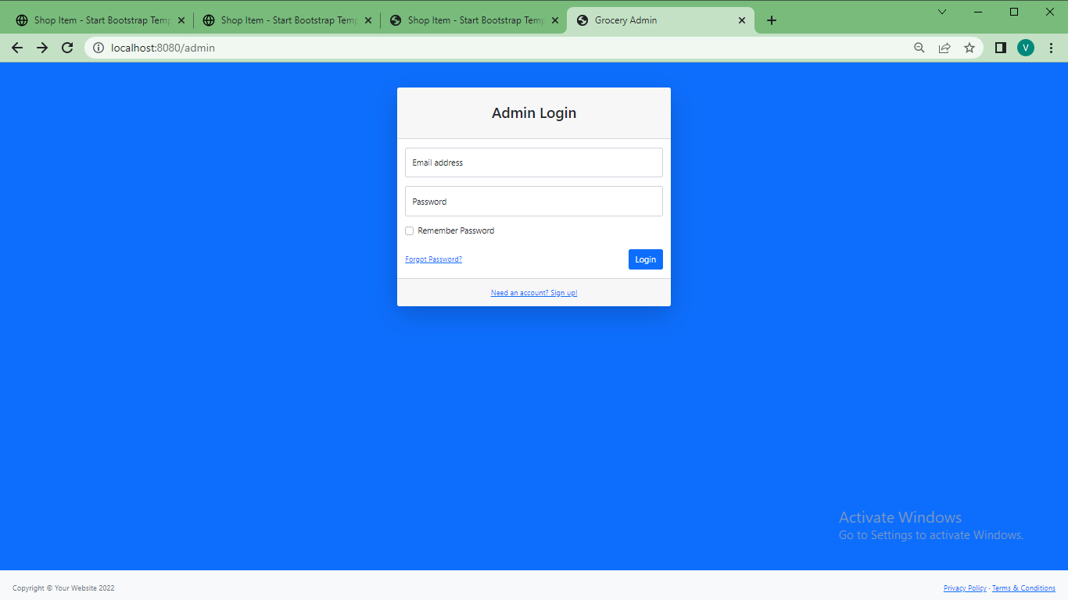

Slide 19






Slide 20


